Slide 1

Final Review

Slide 2
Turing Machines
Deterministic TM
  Configuration; initial configuration
  Computation
  Halting
  Accepting
  Rejecting
  Description
    Graph
    Shorthand
  Deciding = the D class of languages
  Semideciding = the SD class of languages
  Computing functions

Slide 3
TM Extensions
Multiple tapes
  Multi-tape TM is equivalent to deterministic TM
Nondeterministic TM
  Accepting, Rejecting
  Deciding, Semideciding, Computing functions
  Nondeterministic TM are equivalent with deterministic TM
    For deciding, semideciding, computing functions
One-way tape TM
  One-way tape TM is equivalent to deterministic TM
  PDA with two stacks can simulate a TM
TM can simulate real computers

Slide 4
Universal TM
TM encoding
  States, tape alphabet, transitions
Encoding multiple inputs
Enumerating TMs
Universal TM
  Specification
    On input <M,w>, simulate M on w
  Construction
Church-Turing thesis

Slide 5
The Halting Problem
Halting Problem for TM is in SD \ D
  Semidecidable (in SD)
  Not decidable (not in D)
    Trouble
    Diagonalization
H ∈ D ⇒ D = SD

Slide 6
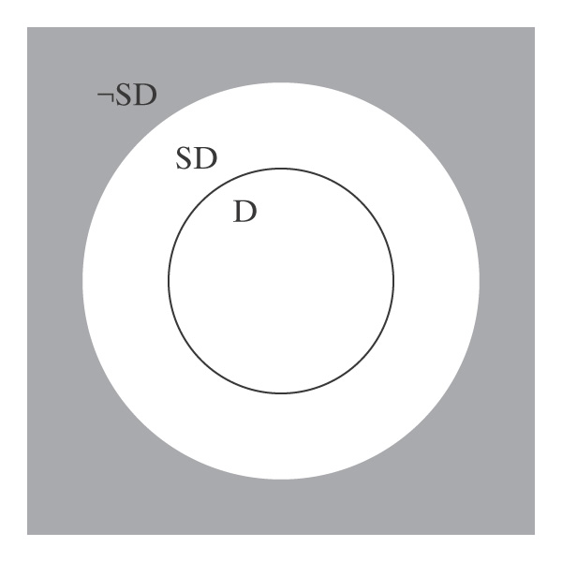
D and SD
D ⊂ SD
SD \ D ≠ ∅ (H is here)
SD is countable
¬SD is uncountable
D is closed under complement
SD is not closed under complement
L ∈ D iff L, ¬L ∈ SD
¬H ∈ ¬SD

Slide 7
Enumeration
TM enumerates
Turing-enumerable language
L ∈ SD iff L is Turing enumerable
TM lexicographically enumerates
Lexicographically Turing-enumerable language
L ∈ D iff L is lexicographically Turing enumerable

Slide 8
Reduction
Reduction:
  L₁ ≤ L₂
    L₁ is reducible to L₂
    L₂ is harder than L₁
Using reduction for undecidability
  Prove that L₂ is not in D
    Find suitable L₁ not in D
    Show that L₁ ≤ L₂
H, H_{ε,} H_{ANY,} A, A_{ε,} A_{ANY} ∈ SD \ D
Rice’s Theorem:
  Any nontrivial property of SD is undecidable.
Practical implications on programs

Slide 9
Non-SD languages
Proving a language L in not in SD
  ¬L ∈ SD \ D
  Reduction from non-SD language
¬H, H_{¬ANY,} EqTMs, H_{ALL}, A_{ALL}, TMreg, A_{anbn} ∉ SD

Slide 10
Unrestricted grammars
Unrestricted grammars
Equivalence with SD
  Grammar → TM
  TM → Grammar
Decision problems
  Undecidability follows from SD

Slide 11
Non-TM problems
Post Correspondence Problem (PCP)
PCP ∈ SD \ D
  L_{a} ≤ MPCP ≤ PCP
Problems of context-free languages
  CFG_{ALL} ∉ D
    Reduction from H
    Computation histories
  CFG₌, PDA_{MIN} ∉ D
    Reduction from CFG_{ALL}
  IntEmpty, CFG_{UNAMBIG} ∉ D
    Reduction from PCP

